Slide 1
DevOps Training:
Cloud Computing
Module 1

Slide 2
Agenda
Cloud Computing
What is Cloud Computing?
Disadvantages with Traditional IT Infrastructure
Advantages of Cloud Computing
Cloud Deployment Models
Cloud Service Models
AWS Suite
AWS Use Cases
AWS Market Trends
Why DevOps?
Traditional IT Vs DevOps
What is DevOps?
Role of Cloud in DevOps Orchestration

Slide 3
What is Cloud Computing?
Cloud computing is the on demand delivery of Compute Power, Database storage, Applications and other IT resources.
Cloud services offer pay-as-you-go pricing model
Provision required type, size and number of instances as you need instantly
Simple way to access servers, storage, databases and a set of application services
Cloud provider owns and maintains their own network connected hardware required for these applications, and you can provision what you need via a Web Application, SDK or a CLI.

Slide 4
Disadvantages with Traditional IT Infrastructure
Pay rent for the data center
Pay for power, cooling and maintenance
Adding and replacing hardware takes time
Scaling is limited
Hire 24/7 team to monitor infrastructure
Dealing with disasters like earthquakes, cyclones and power shut down

Slide 5
Advantages of Cloud Computing
Trade Capital Expense (CAPEX) for operational Expense (OPEX)
Pay on demand and Don’t own hardware
Reduce total cost of ownership (TCO) & Operational Expense (OPEX)
Benefits from massive economies of scale
Prices are reduced as AWS is more efficient due to large scale
Stop guessing capacity
Scale based on actual measured usage
Increased speed and agility
Stop spending money on running and maintaining data centers
Go Global in minutes

Slide 6
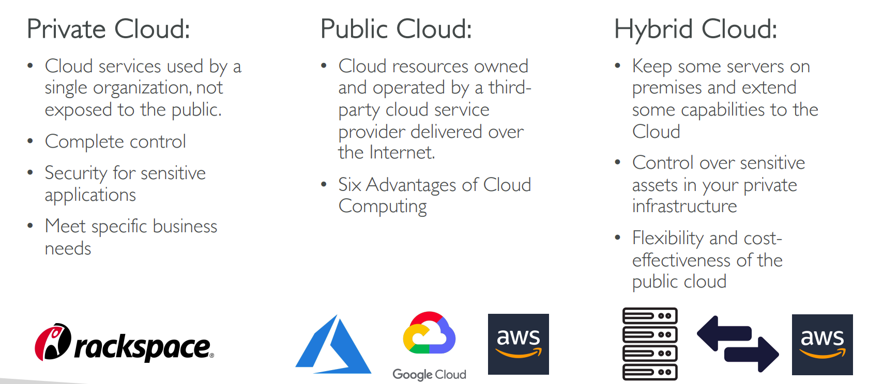
Deployment Models

Slide 7
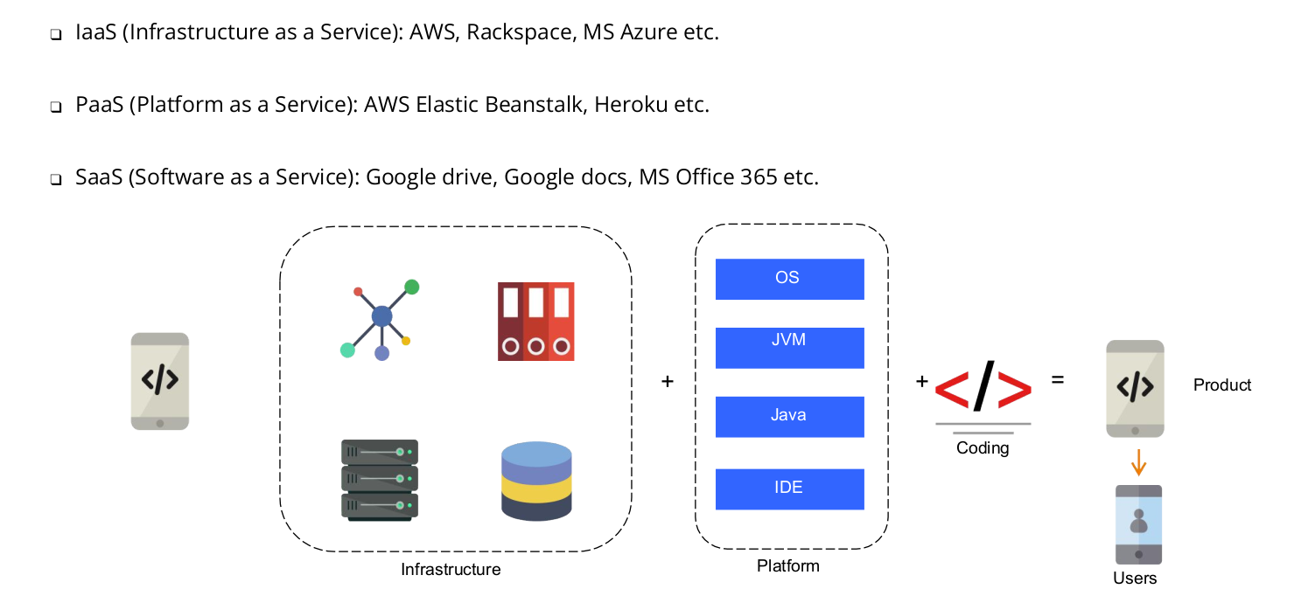
Cloud Service Models

Slide 8
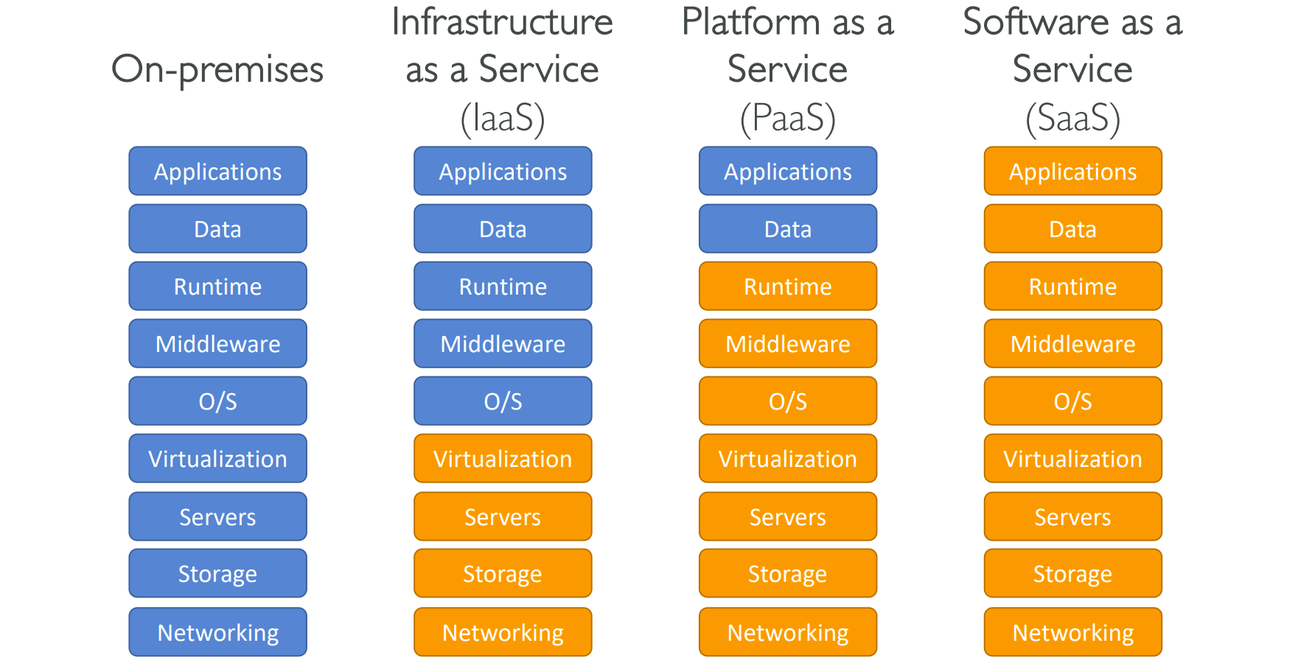
Cloud Service Models

Slide 9
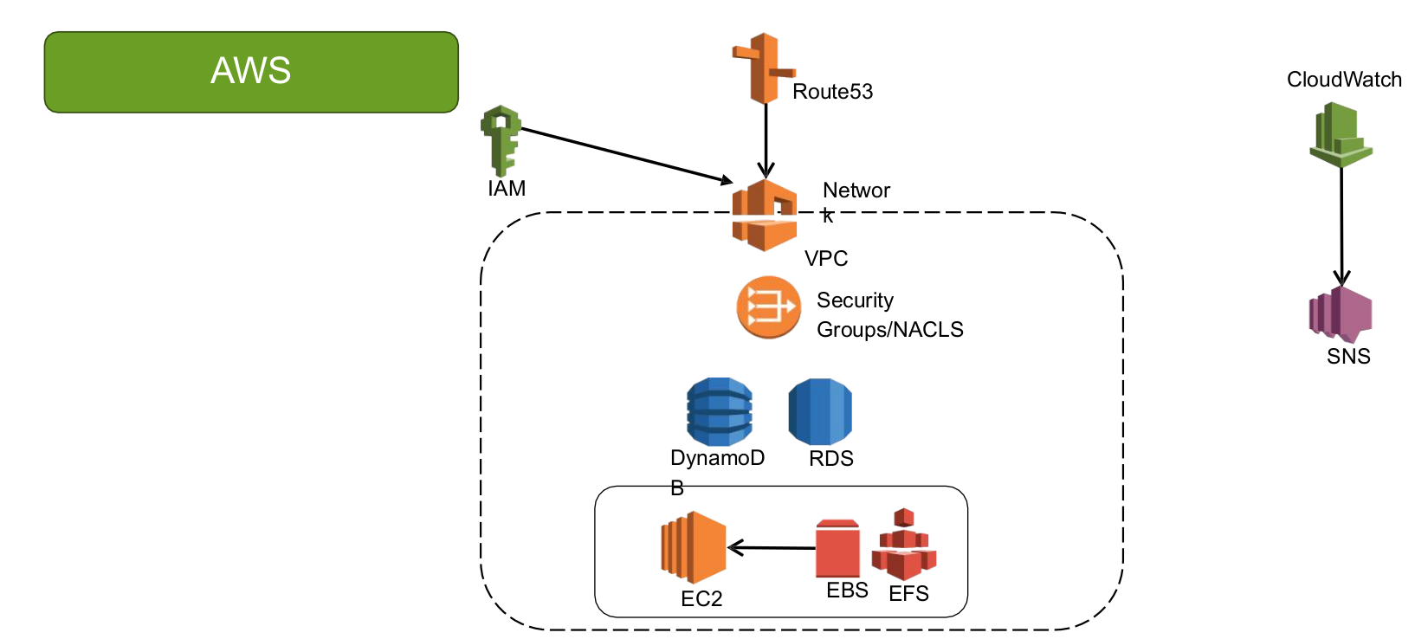
AWS Suite

Slide 10



AWS Cloud Use Cases
AWS enables you to build sophisticated, scalable applications
Applicable to diverse set of industries
Use cases include
Enterprise IT, Backup & Storage, Big Data Analytics
Website hosting, Mobile & Social Apps
Gaming
Lot of companies are also using AWS including the following shown

Slide 11
AWS Market Trends

Slide 12
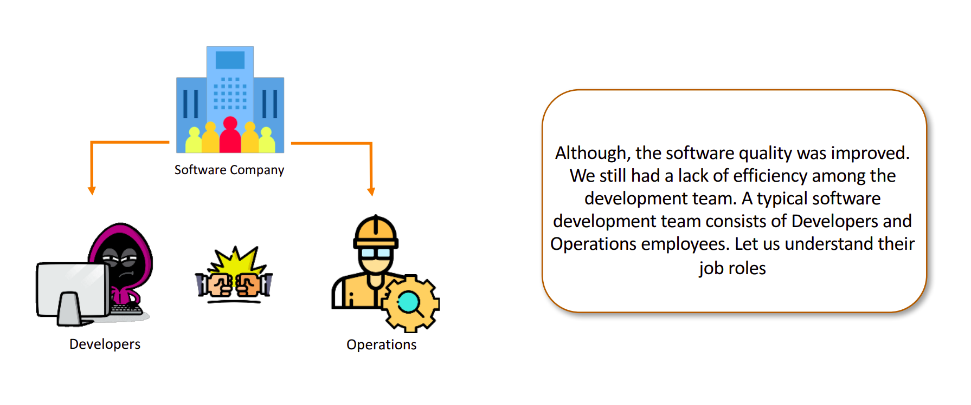
Why DevOps?

Slide 13
Why DevOps?

Slide 14
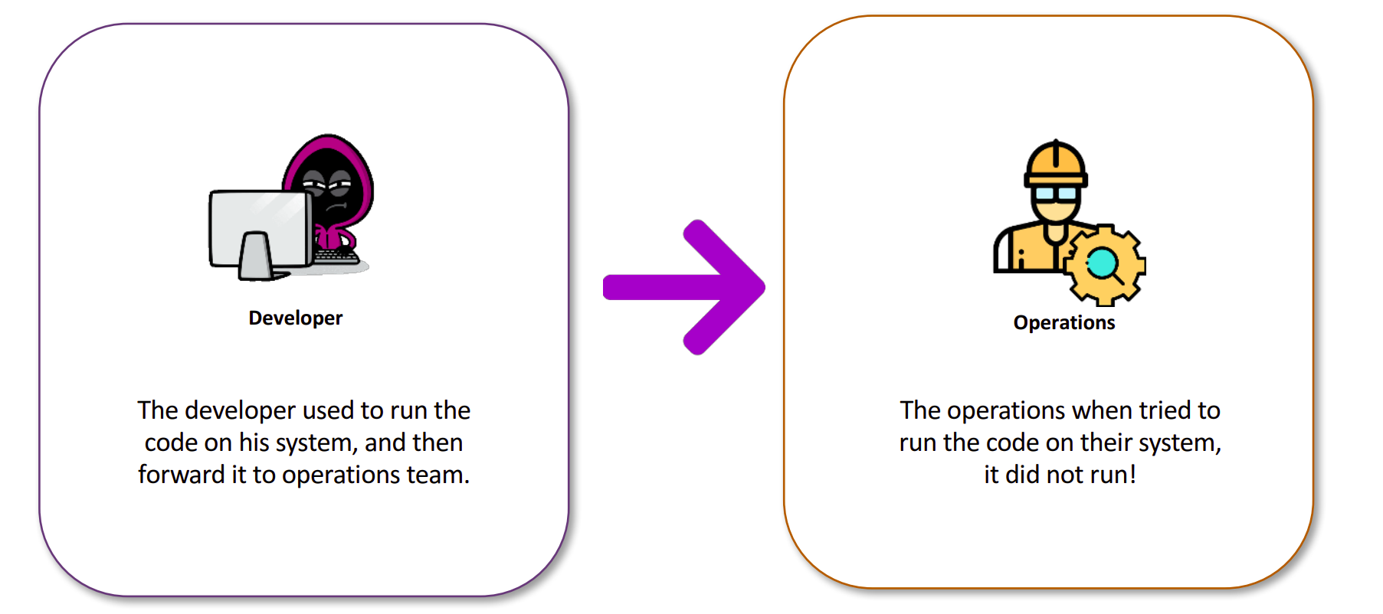
Why DevOps?

Slide 15
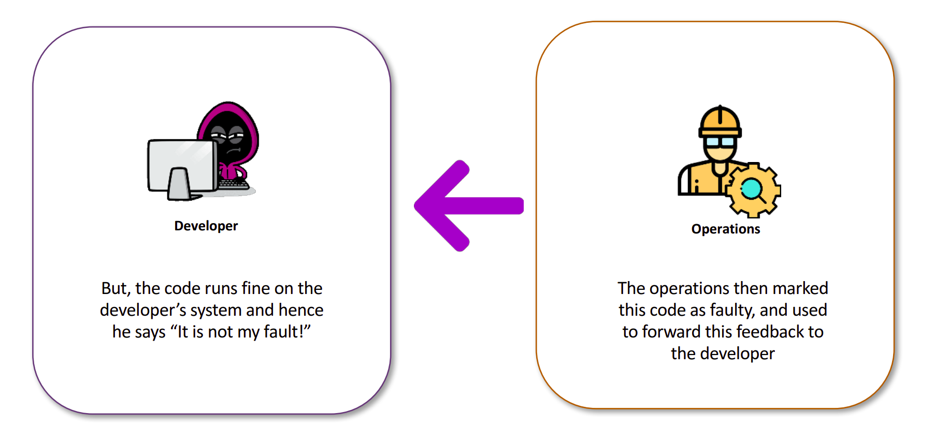
Why DevOps?

Slide 16
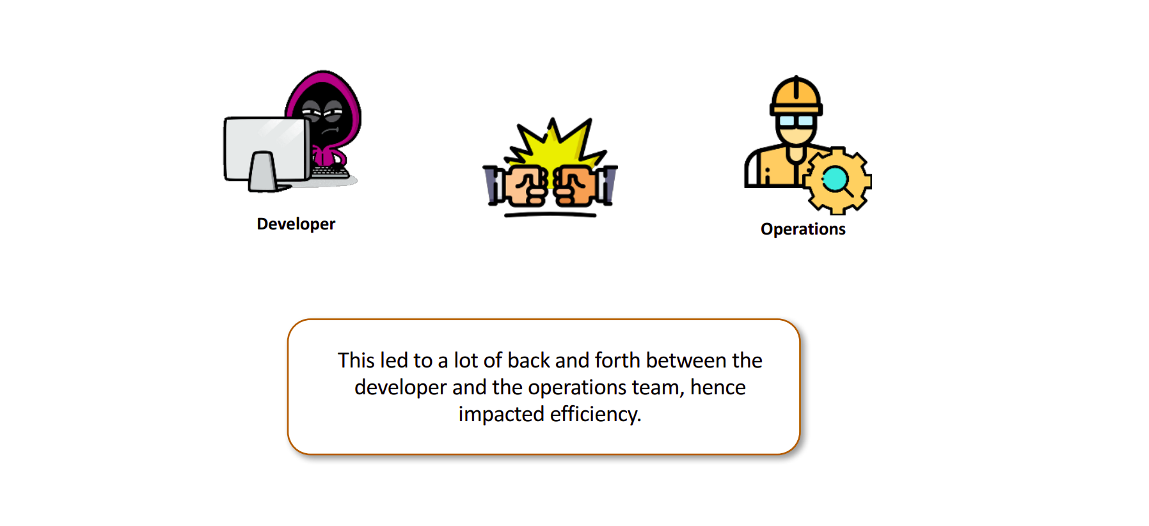
Why DevOps?

Slide 17
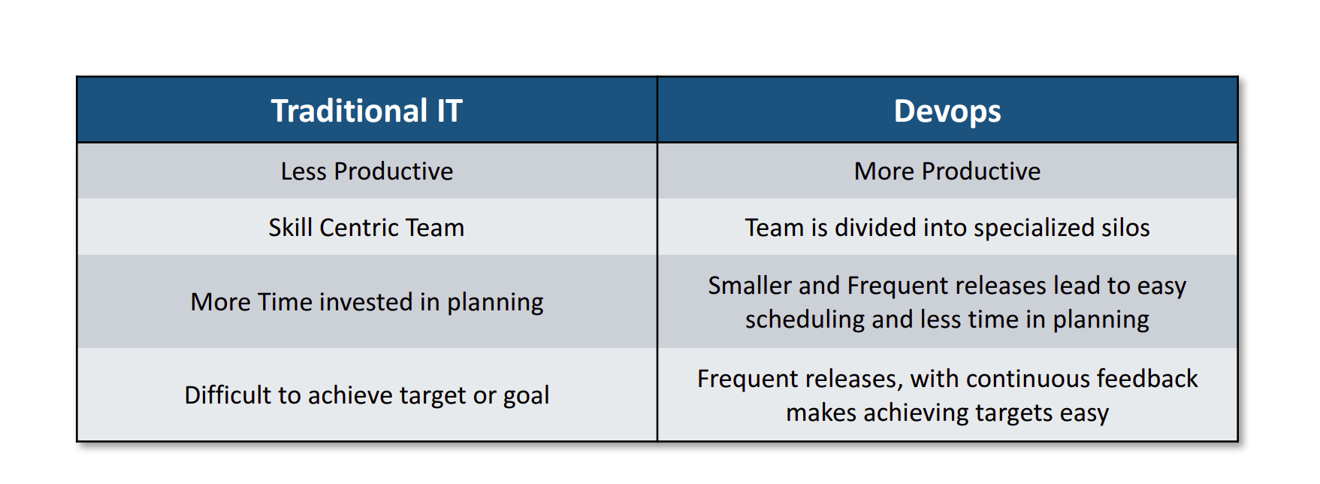
Traditional IT Vs DevOps

Slide 18
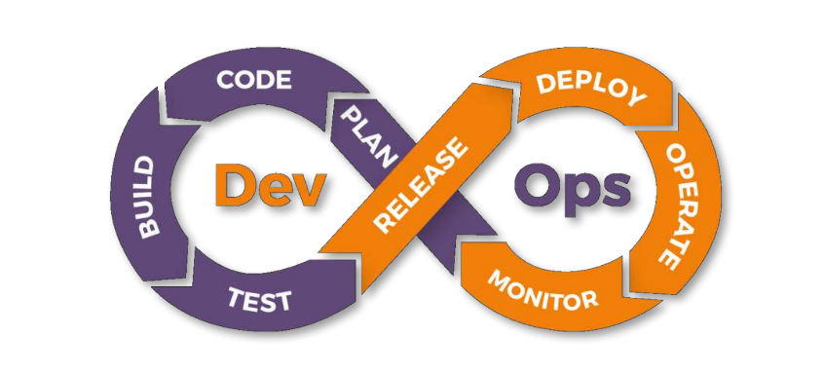
What is DevOps?
DevOps is a software development methodology which improves the collaboration between developers and operations team using various automation tools. These automation tools are implemented using various stages which are part of the DevOps lifecycle.

Slide 19
Role of Cloud in DevOps Orchestration
Scalability and Flexibility
Infrastructure as Code
Automated Deployment and Continuous Integration
Resource Optimization
Collaboration and Communication
Monitoring and Logging
DevSecOps and Compliance
High Availability and Disaster Recovery

Slide 20
Thank you!
Please don’t forget to….
share your feedback
Mark your attendance

